Slide 1
Ch. 10: New Product Development

Slide 2
Marketing Strategy Overview – Basic Structure
Analyze the environment and set the strategy
Company
(strengths & weaknesses)
Customers
Segment the market
Target your customers
Position your product
Competition
Product
Price
Promotion
Place
Leveraging real tools to implement strategic objectives

Slide 3
Preview
The benefits and attributes of a product
Product mixes, product lines, and product item
Types of products
New products
NPD process
Test-marketing

Slide 4

Pitiful is the person who is afraid of taking risks. Perhaps this person will never be disappointed or disillusioned perhaps he won´t suffer the way people do when they have a dream to follow. But when the person looks back-she will hear her heart break.
- Paulo Coelho

Slide 5
Product
Anything that satisfies consumer needs
“Bundle of benefits” vs. “Bundle of attributes”
Example: Cars
Benefits Attributes
Economic transportation → Price
Sporty feeling → Engine capacity, Horsepower, styling
Luxury → Heated leather seats, GPS
Consumers focus on attributes as a way to achieve benefits

Slide 6
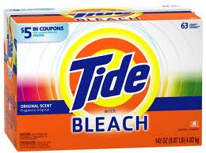
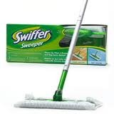
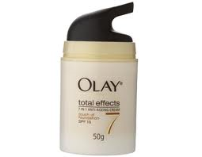
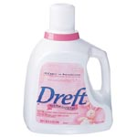
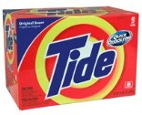
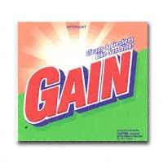
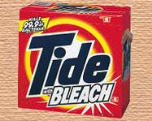
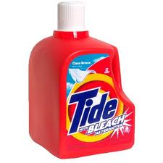
Products
Product mix
All product lines offered by a company (all products offered by P&G)
Product line
Group of closely related products (laundry detergents from P&G)
Product item
A specific product within a product line (Tide with bleach laundry detergent)
Product Form
How the product is presented
SKU (Stock keeping unit)
Each size of a product item (77 oz vs 52 oz size of Tide with bleach)

Slide 7
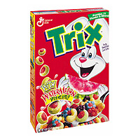

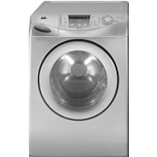



Classifying products
Nondurable goods
Immediately consumed (over a few uses)
Durable goods
Lasts over many uses
Services
Intangible
Which of these are high vs. low involvement purchases?

Slide 8






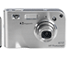



Consumer products
Inexpensive, purchased frequently, widely available
More expensive, purchased infrequently, more shopping time
Very expensive, uniqueness and status emphasized
Convenience
Products
Specialty
Products
Shopping
Products
Level of Effort expended
Unsought products: Consumers unaware of need or not seeking solution

Slide 9
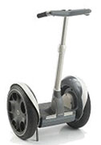
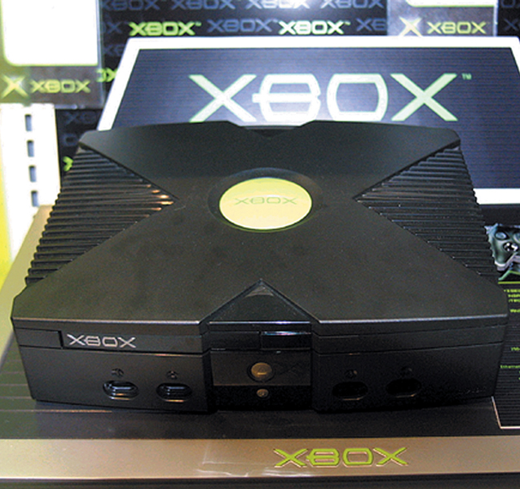
What is a new product?
New compared with existing products
Functionally different from what currently exists
New (in legal terms)
Introduced to market in last 6 months
New from the company’s perspective
Line extension, technological innovation, brand extension to new product category
New from consumer’s perspective
Degree of learning required by customer

Slide 10
Toy Story
Consumer Insights:
Kids were spending more and more time on computers, and creating custom avatars, but they never got a tangible outcome to play with or show off.
2. Also, kids loved drawing and making things, but became easily frustrated because their skills hadn’t caught up with what they saw in their minds.
3. Although kids had access to a few products with customizable options, such as Build-a-Bear, they didn’t have any truly do-it-yourself toys.

Slide 11
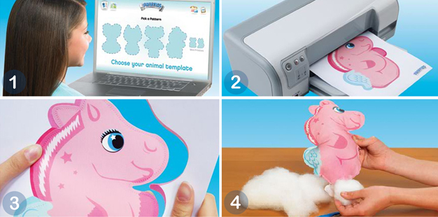
IDEO: Product Innovators
http://www.ideo.com/work/long-haul-travel-experience/

Slide 12
New Product development: Its hard to forecast the future
“I think there is a world market for maybe five computers.”
“There is no reason anyone would want a computer in their home.”
“Who the hell wants to hear actors talk?”
“Well informed people know it is impossible to transmit the voice over wires, and even if it were possible the thing would have no practical value”
Thomas Watson, chairman of IBM, 1943
Ken Olson, chairman and founder of Digital Equipment Corp., 1977
H.M. Warner, Warner Brothers, 1927
Editorial in the Boston Post, 1865

Slide 13
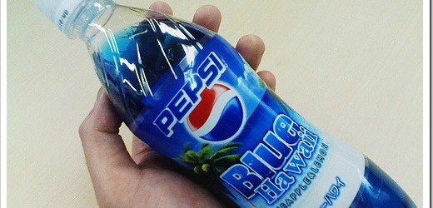
Product development risks
Failure rates
“…no more than 10% of all new products or services are successful -- that is, still on the market and profitable after three years” - Marketing Management (2003)
95% of new consumer products in US fail; 90% of new consumer products in Europe fail - Nielsen BASES and Ernst & Young study (2002)
Costs
Introducing a new national brand can cost $20 million – Marketing Management
According to New Product News “It probably
costs $100 million to
introduce a truly new soft drink
nationally

Slide 14
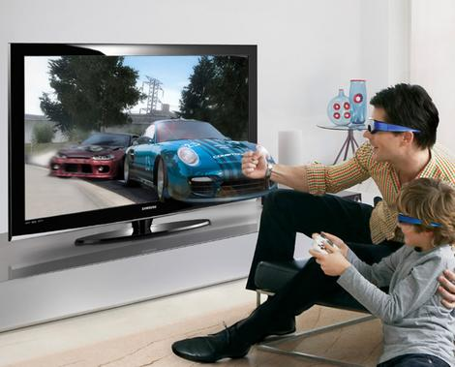
Why do products fail?
Too small a target market

Slide 15
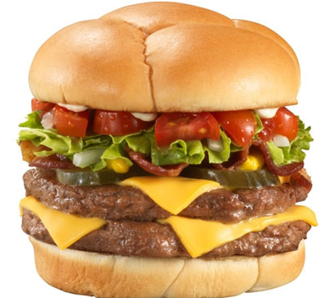
Why do products fail?
Too small a target market
Insignificant point of difference
In 1996 McDonald’s decided to design a new menu item that would appeal to a more sophisticated, adult demographic — the result was the Arch Deluxe burger. The general public couldn’t distinguish the new sandwich enough from the classic Big Mac to make it a hit.

Slide 16
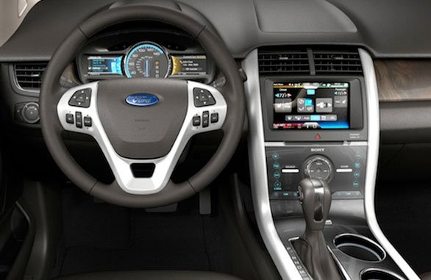
Why do products fail?
Too small a target market
Insignificant point of difference
Poor product quality
MyFord Touch
Replaces traditional dashboard knobs and buttons with a touchscreen. Drivers control climate, navigation, entertainment, phone calls and other functions, using touch/voice commands.
23% of new owners have problems with MyFordTouch
Notes:
MyFord Touch debuted in 2010 on the Ford Edge and replaces traditional dashboard knobs and buttons with a touchscreen. Drivers control climate, navigation, entertainment, phone calls and other functions, using touch or voice commands. But dealer phone lines and internet chatrooms were soon buzzing with complaints. The system would shut down without warning and took too long to reboot. It didn't understand voice commands and didn't always respond to owners' touch commands. Some owners found the information-packed screens overwhelming.

Slide 17
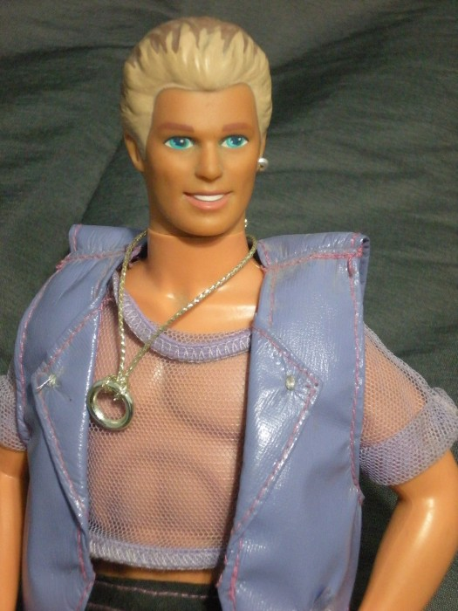
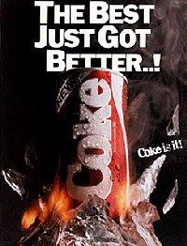
Why do products fail?
Too small a target market
Insignificant point of difference
Poor product quality
Poor use of research
Earing Magic Ken
Notes:
Mattel had conducted a survey of 5 year old girls asking if Ken should be retained as Barbie's boyfriend or whether a new doll should be introduced in that role. Survey results indicated that girls wanted Ken kept but wanted him to look "cooler."^{[3]} The redesigned Ken was the result.

Slide 18

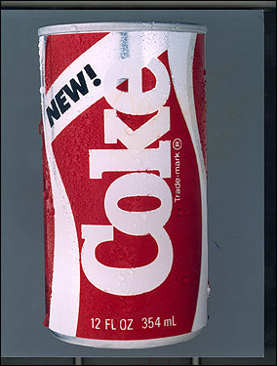
Data Collection Gone Wrong: New Coke
Launched in 1985 with a sweeter, smoother taste
Marketing research
Pepsi challenge
2 years and $4 million spent on research
200,000 taste tests, 30,000 on the final formula
60% of consumers chose the new Coke over the old Coke and 52% chose it over Pepsi
Consumer reaction
1500+ angry phone calls, sacks of complaint letters
Protest demonstrations, class action suits threatened
What was the problem?
Too narrow a definition of the problem
Research considered only taste not how consumers felt about the entire branded product
New Coke

Slide 19



Why do products fail?
Too small a target market
Insignificant point of difference
Poor product quality
Poor use of research
Bad timing Edsel GO CORP Tablet
“Being early is the same as being wrong"
VS
GO Corporation
Tablet

Slide 20
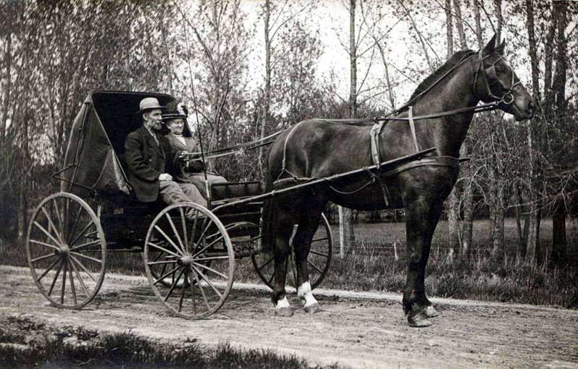
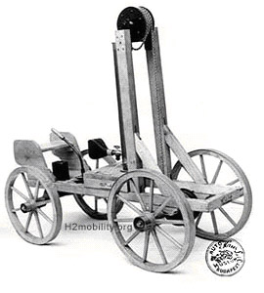
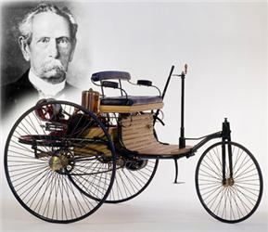
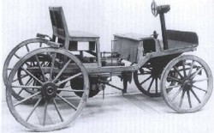
New Products Must Relate Appropriately to Old Products
Originally called “horseless carriages” so people could understand the product

Slide 21
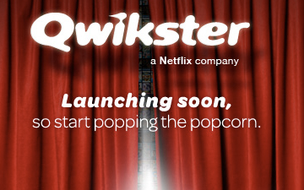
Why do products fail?
Too small a target market
Insignificant point of difference
Poor product quality
Poor use of research
Bad timing
Poor execution of the marketing mix
Netflix attempted to launch Qwikster in 10th paragraph of letter apologizing for another marketing gaffe (unilaterally increasing prices)
Notes:
Launched quickster in 10th paragraph of letter apologizing for another marketing gaffe

Slide 22
Why do products fail?
Too small a target market
Insignificant point of difference
Poor product quality
Poor use of research
Bad timing
Poor execution of the marketing mix
Inadequate budget

Slide 23


Why do products fail?
Too small a target market
Insignificant point of difference
Poor product quality
Poor use of research
Bad timing
Poor execution of the marketing mix
Inadequate budget
No economical access to buyers
New products have to justify their retail
locations

Slide 24
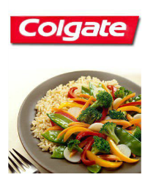

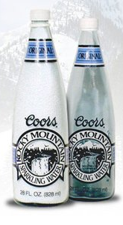
Consumer Disconnect
Disposable Underwear
Colgate Stir-fry
Coors Rocky Mountain Water

Slide 25
Why new products succeed?
Top-management commitment
Start with the consumer -- not the factory
Intelligent use of research
Exploit a competitive advantage
Speed to market

Slide 26
New Product Development process
New product strategy
development
Idea generation
Screening and evaluation
Business analysis
Development
Market testing
Commercialization
Commercialized products

Slide 27
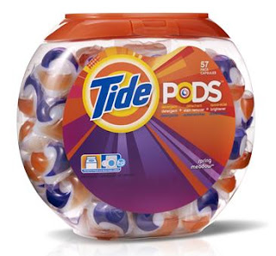

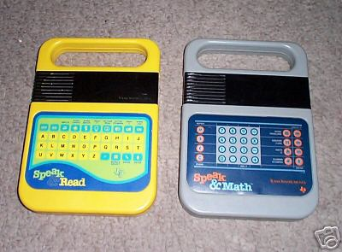

Idea Generation: Sources
Technology
Market needs and user solutions
Tide Pods (people don’t like mess of pouring)
Competitors and other firms
Facebook → Google+, Diaspora
Management and employees
TI’s Speak ’n’ Spell toys
Environmental changes
TSA approved locks for travel

Slide 28
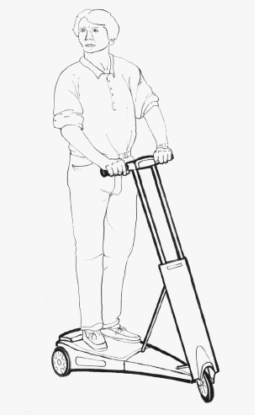
Screening and Evaluation
Internal
Professional Product testers
External: Concept testing
The product is a lightweight electric scooter that can be easily folded and taken with you inside a building or on public transportation.
The scooter weighs about 25 pounds. It travels at speeds of up to 15 miles per hour and can go about 12 miles on a single charge.
The scooter can be recharged in about two hours from a standard electric outlet.
The scooter is easy to ride and has simple controls — just an accelerator button and a brake.

Slide 29
New Product Development process
Business analysis
Last checkpoint before significant investment
Create a strategy to bring to market
Financial analysis
Development
Prototype of product

Slide 30
New Product Development process
Business analysis
Last checkpoint before significant investment
Create a strategy to bring to market
Financial analysis
Development
Prototype of product
Testing
Internal and with consumers

Slide 31
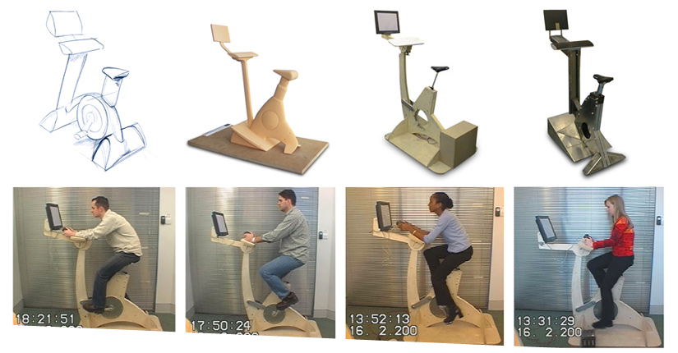

Slide 32
Test marketing
Standard
Full marketing campaign in a few cities
Controlled
Limited to a few stores
Simulated
Testing in a simulated marketing environment
Qualified consumers are shown TV or print ads and given money to buy or not buy

Slide 33
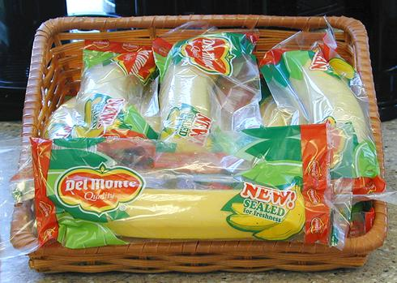
Benefits of test marketing
Yields a more reliable forecast of future sales than no testing.
Can pre-test alternative marketing plans.
May discover a product fault missed in the product development stage.
Discover clues to distribution problems.
Dallas-area locations will test market a new plastic wrap developed by supplier Fresh Del Monte Produce to keep single bananas yellow and firm for five days — more than double the two-day shelf life for an unwrapped banana.

Slide 34
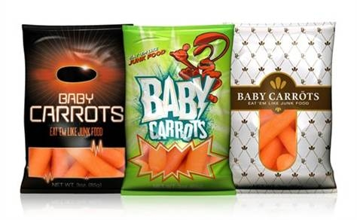
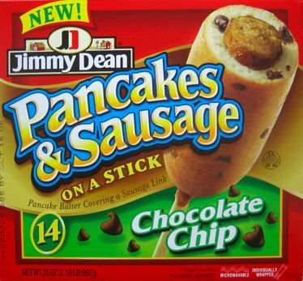
Problems with test marketing
Problem of obtaining a set of markets that is reasonably representative of the country as a whole.
Problem of competitive knowledge of your test. Maybe they don’t know (care) what else is out there
Problem of translating national media plans into local equivalents.

Slide 35

How Do I test Market?

Slide 36
Actions from test marketing
High trial, high repurchase rate GO
High trial, low repurchase rate Drop or redesign product
Low trial, high repurchase rate Increase advertising and sales promotion
Low trial, low repurchase rate Drop product

Slide 37

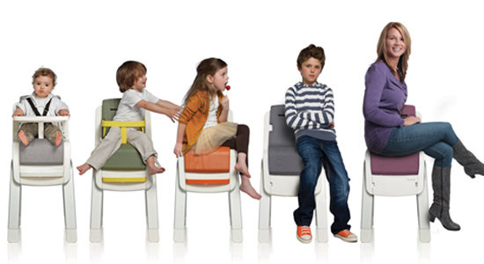
3M Greptile Glove
BabyBjörn's High
Chair

Slide 38
Think About
Who are some target segments for the Each Product
What do you suspect was the source for idea?
What is the key point of difference?
Does this product have potential and Why or Why Not?

Slide 39
Review
What is the New Product Development process?
Categories of products
What are some problems with test marketing?
What constitutes a new product?
Why do new products fail or succeed

